Slide 1

Electricity Merit Badge
Troop 344 and 9344
Pemberville, OH

Slide 2
Electricity Merit Badge Requirements
Demonstrate that you know how to respond to electrical emergencies by doing the following:
  Show how to rescue a person touching a live wire in the home.
  Show how to render first aid to a person who is unconscious from electrical shock.
  Show how to treat an electrical burn.
  Explain what to do in an electrical storm.
  Explain what to do in the event of an electrical fire.
Complete an electrical home safety inspection of your home, using the checklist found with this presentation or one approved by your counselor. Discuss what you find with your counselor.
Make a simple electromagnet and use it to show magnetic attraction and repulsion.

Slide 3
Electricity Merit Badge Requirements
Explain the difference between direct current and alternating current.
Make a simple drawing to show how a battery and an electric bell work.
Explain why a fuse blows or a circuit breaker trips. Tell how to find a blown fuse or tripped circuit breaker in your home. Show how to safely reset the circuit breaker.
Explain what overloading an electric circuit means. Tell what you have done to make sure your home circuits are not overloaded.
Make a floor plan wiring diagram of the lights, switches, and outlets for a room in your home. Show which fuse or circuit breaker protects each one.

Slide 4
Electricity Merit Badge Requirements
Do the following:
  Read an electric meter and, using your family's electric bill, determine the energy cost from the meter readings.
  Discuss with your counselor five ways in which your family can conserve energy.
Explain the following electrical terms:
Volt | Ampere | Watt
Ohm | Resistance | Potential Difference
Rectifier | Rheostat | Conductor
Ground | Circuit | Short Circuit

Slide 5
Electricity Merit Badge Requirements
Do any TWO of the following:
  Connect a buzzer, bell, or light with a battery. Have a key or switch in the line.
  Make and run a simple electric motor (not from a kit).
  Build a simple rheostat. Show that it works.
  Build a single-pole, double-throw switch. Show that it works.
  Hook a model electric train layout to a house circuit. Tell how it works.

Slide 6
Requirement 1
Demonstrate that you know how to respond to electrical emergencies by doing the following:
  Show how to rescue a person touching a live wire in the home.

Slide 7
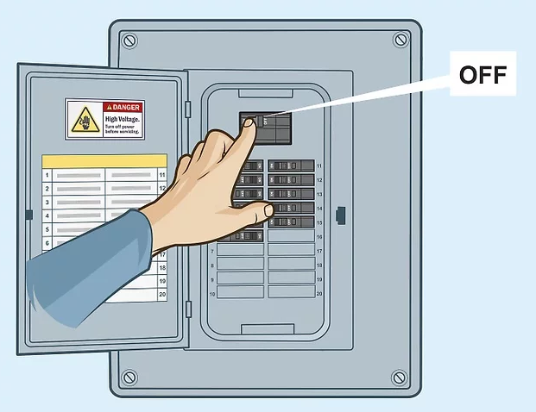
Requirement 1
If someone is in contact with a live circuit, do not touch the person. You can become “stuck” to him and part of the electrical field.
If the service panel is nearby, quickly shut off the house current by throwing the main circuit breaker.
If it is a long way to the service panel, or you do not know where the panel is, use a non-conducting object such as a wooden chair, wooden broom handle, rug, or rubber doormat to separate the person from the live wire.
Never use a metal or wet object.
If the person is not breathing after the rescue, call 911 for medical assistance and start CPR immediately.

Slide 8
Requirement 1
Demonstrate that you know how to respond to electrical emergencies by doing the following:
  Show how to render first aid to a person who is unconscious from electrical shock.

Slide 9
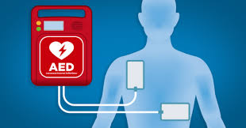
Requirement 1
First aid for a person unconscious from electrical shock.
Call 911 or send someone to call and obtain a defibrillator.
The order of treatment in a life-threatening emergency is A-B-C-D: Airway, Breathing, Circulation, and Defibrillation.
  Open airway.
  Check for breathing.
  If no breathing, begin CPR.
  When defibrillator arrives, turn the AED on and follow the voice prompts.
  Keep CPR going while AED is being set up.

Slide 10
Requirement 1
Demonstrate that you know how to respond to electrical emergencies by doing the following:
  Show how to treat an electrical burn.

Slide 11
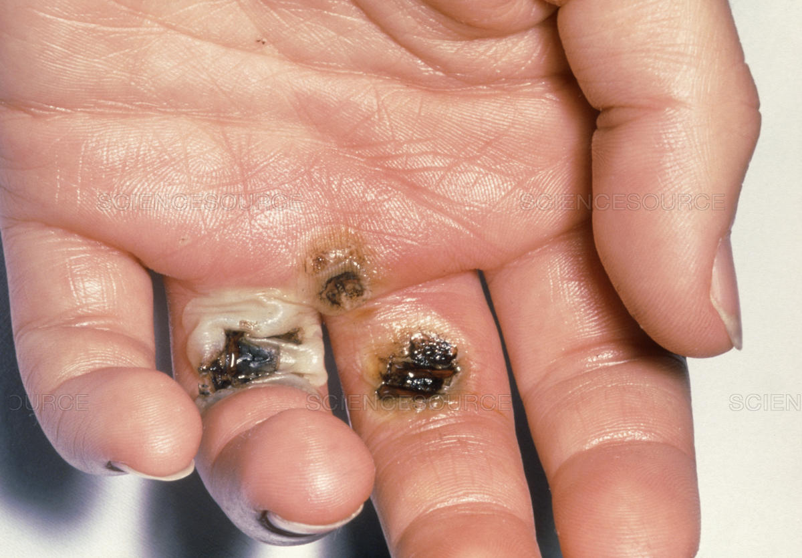
Requirement 1
Don't touch the injured person if he or she is still in contact with the electrical current.
Electric shock causes burns inside the body, so immediately seek medical attention for the victim.
Do not apply ice, butter, ointments, medication, bandages, or cotton dressings to electrical burns.
Do not touch burns, break blisters, or remove burned clothing.
Try to prevent the injured person from becoming chilled.

Slide 12
Requirement 1
Demonstrate that you know how to respond to electrical emergencies by doing the following:
  Explain what to do in an electrical storm.

Slide 13
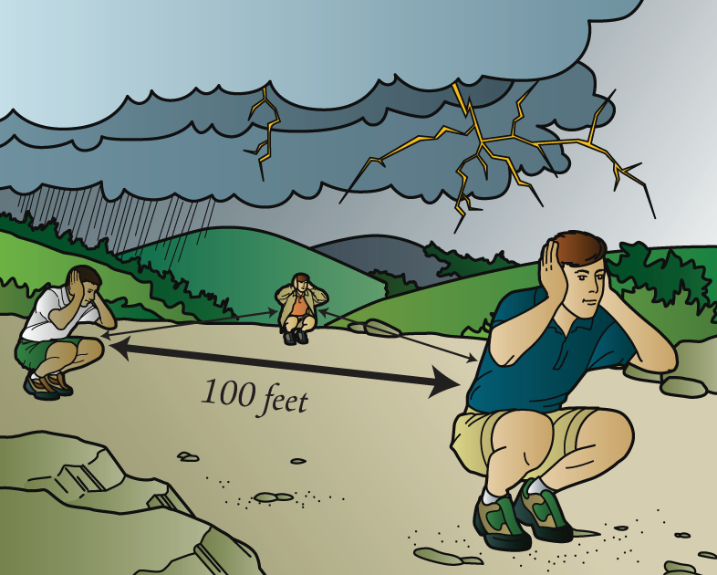
Requirement 1
If caught in the outdoors when a storm approaches, move away from open water, mountaintops, the crests of ridges, and the bases of tall or solitary trees.
A dense forest located in a depression offers the most protection.
In a tent, stay away from metal tent poles.
If an electrical storm catches your group in the open, spread out so people are at least 100 feet from one another.
Become the smallest target you can by squatting on the balls of your feet, cover your ears with your hands, and get your head close to your knees.

Slide 14
Requirement 1
Demonstrate that you know how to respond to electrical emergencies by doing the following:
  Explain what to do in the event of an electrical fire.

Slide 15
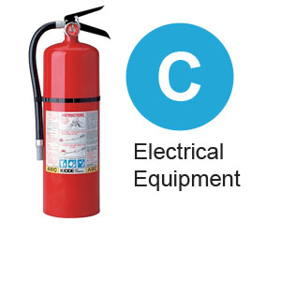
Requirement 1
Electrical fires are different from other fires.
Never use water on an electrical fire.
Turn off the main power to the house.
Use only extinguisher rated for electrical fires (Class C).
If the fire cannot be safely put out, leave the house immediately and take everyone with you.
Call 911 from the nearest phone once you and your family are safely away from your home.

Slide 16
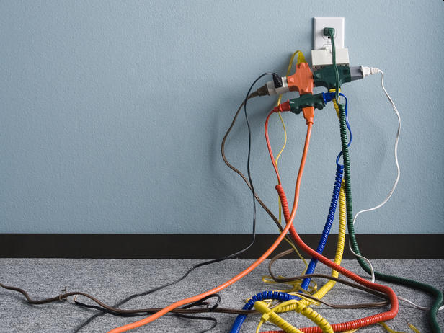
Requirement 2
Complete an electrical home safety inspection of your home. Download the checklist found with this presentation. Discuss what you find with your counselor.

Slide 17
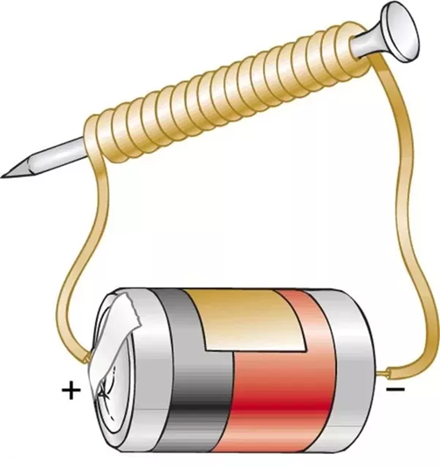
Requirement 3
Make a simple electromagnet and use it to show magnetic attraction and repulsion.
  Download the instructions titled “How do I make an electromagnet?” found with this presentation.

Slide 18
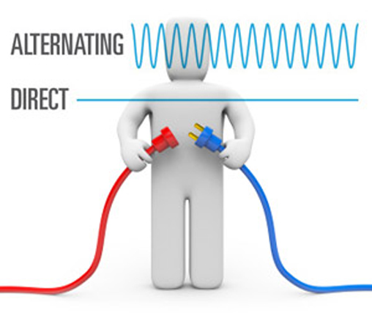
Requirement 4
Explain the difference between direct current and alternating current.

Slide 19
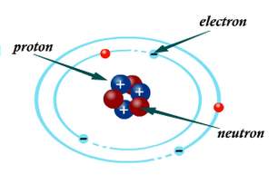
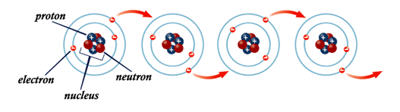
Requirement 4
Electricity is the flow of electrons.
All matter is made up of atoms, and an atom has a center, called a nucleus.
When electrons are "lost" from an atom and get “bumped” from one atom to the next, this continuous flow of electrons from atom to atom through a conductor is called electric current.
Electricity is a basic part of nature and it is one of our most widely used forms of energy.
There are two types of Electricity, Static Electricity and Current Electricity.

Slide 20
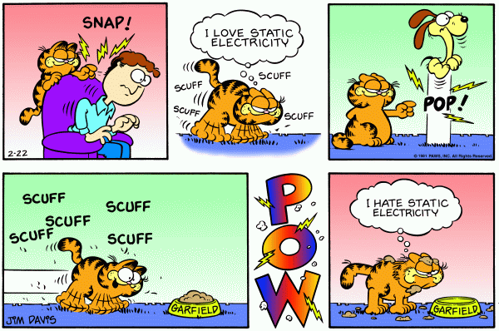
Requirement 4
Static Electricity:
Is the buildup of positive or negative charges on the surface of an object.
These charges build up when two objects rub against each other and electrons pass from one object to the other.
  An example if this would be the shock you get from touching a metal doorknob after walking across a carpeted floor.

Slide 21
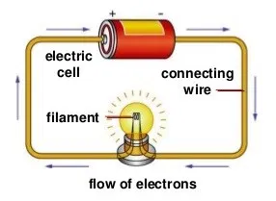
Requirement 4
Current Electricity:
Is the flow of electrons along a conductor.
Unlike static electricity, current electricity is always in motion.
Current electricity is used for many practical applications, like powering our lights and home appliances.
  There are two types of current electricity, Alternating Current (AC) and Direct Current (DC).

Slide 22
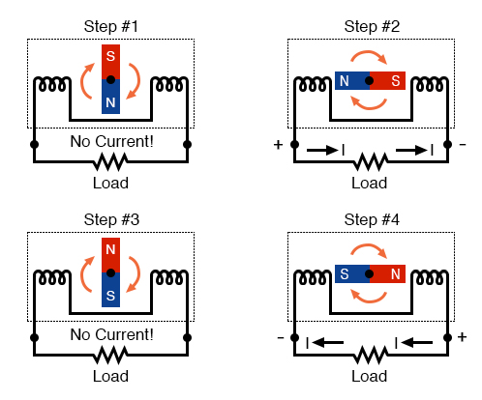
Requirement 4
Alternating Current (AC):
AC electricity is the flow of an electrical charge that changes direction periodically.
The voltage of the charge can vary, meaning it can become more or less intense.
Practical applications of AC electricity include:
  Production and transportation of electricity
  Home and office outlets
  Appliances
Notice how the polarity of the voltage across the wire coils reverses as the opposite poles of the rotating magnet pass by. Connected to a load, this reversing voltage polarity will create a reversing current direction in the circuit.

Slide 23
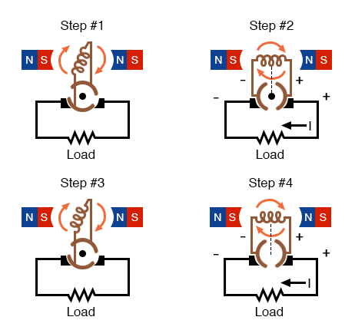
Requirement 4
Direct Current (DC):
DC electricity consists of a charge that moves in only one direction.
Given its consistency of movement, DC electricity provides a constant level of voltage.
Examples of DC electricity use include:
  Car batteries
  Laptop computers
  Cell phones
  Flat-screen TVs (AC goes into the TV, which is converted to DC)
The generator shown above will produce two pulses of voltage per revolution of the shaft, both pulses in the same direction (polarity).

Slide 24
Requirement 5
Make a simple drawing to show how a battery and an electric bell work.

Slide 25
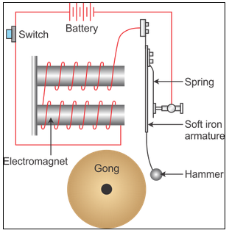
Requirement 5
An electric bell contains an electromagnet, consisting of coils of insulated wire wound round iron rods.
When an electric current flows through the coils, the rods become magnetic and attract a piece of iron attached to a clapper.
The clapper hits the bell and makes it ring.

Slide 26
Requirement 6
Explain why a fuse blows or a circuit breaker trips. Tell how to find a blown fuse or tripped circuit breaker in your home. Show how to safely reset the circuit breaker.

Slide 27
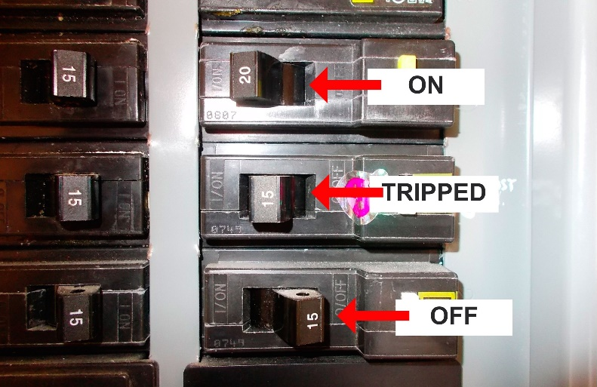
Requirement 6
An overloaded circuit is the most common reason for a circuit breaker tripping.
It occurs when a circuit is attempting to draw a greater electrical load than it is intended to carry.
When too many appliances or light fixtures are operating at the same time, the internal sensing mechanism in the circuit breaker heats up, and the breaker "trips," and renders the circuit inactive before a fire can break out.
To find a tripped breaker, look at your panel for a breaker that is now in the “off” position or between “on” and “off.”
If it's placed in between, move the breaker to the “off” position before returning it to the “on” position.

Slide 28
Requirement 7
Explain what overloading an electric circuit means. Tell what you have done to make sure your home circuits are not overloaded.

Slide 29
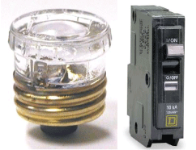
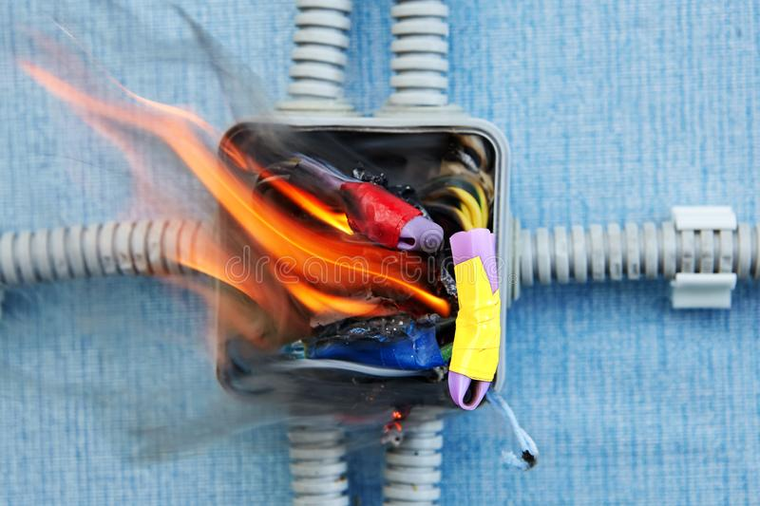
Requirement 7
An overload occurs when you draw more electricity than a circuit can safely handle.
Circuits are made up of wiring, a breaker (or a fuse, in old wiring systems), and devices (such as light fixtures, appliances, and anything plugged into an outlet).
If the current exceeds the breaker rating, the circuit breaker will open up, cutting off any more current flow to protect the wiring.
Without overload protection wires can get hot, or even melt the insulation and start a fire.

Slide 30
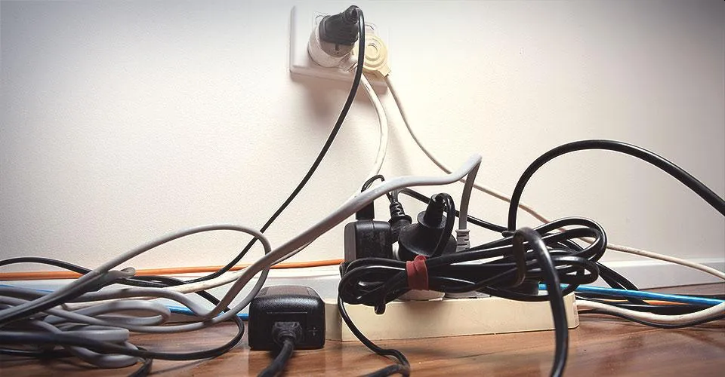
Requirement 7
How to prevent circuit overload.
Often, the cause of an overloaded circuit is the use of too many electrical devices on the same circuit at the same time.
  Balance the power load by plugging one of your high-use appliances into a different circuit.
  Don’t try to get around overloading your circuits by stringing multiple-extension cords together (This is a fire hazard!)
If switching circuits doesn’t solve the issue, faulty wiring may be the problem and it is best to hire an electrician to conduct an electrical inspection.

Slide 31
Requirement 8
Make a floor plan wiring diagram of the lights, switches, and outlets for a room in your home. Show which fuse or circuit breaker protects each one.

Slide 32
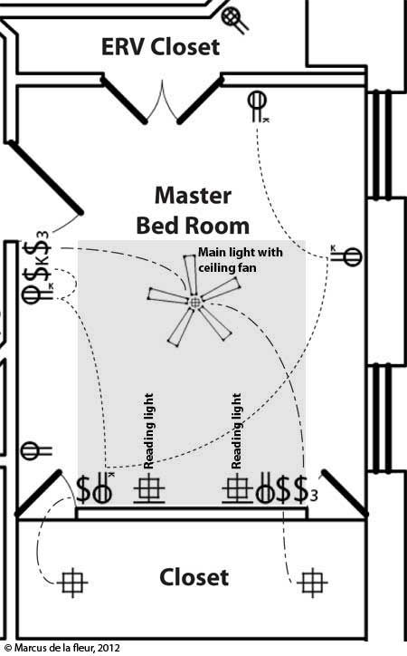
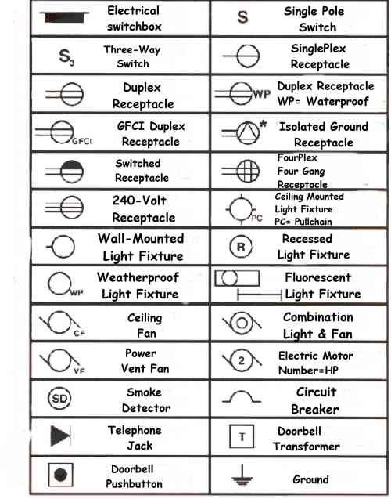
Requirement 8
Draw a simple floor plan of a room in your house with lights, switches, and electrical outlets penciled in.
Then use the electrical wiring symbols to draw in the overhead and wall lights and to show where electric switches and electrical outlets are located.

Slide 33
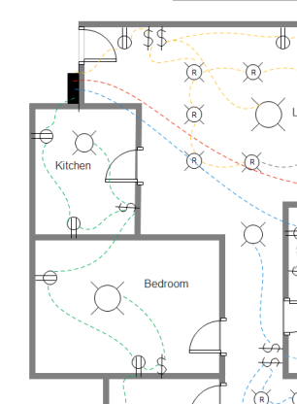
Requirement 8
Ask a parent or guardian to go to the main breaker box and turn off the circuit that supplies power to the room you have chosen.
  Turn on the lights in the room before the adult flips off the circuit breaker.
  If there is more than one circuit breaker that corresponds to the room, note which breaker supplies power to what outlets, lights, and switches by checking them while the power is off.
To the side of your room drawing, make a box and highlight the circuit breakers that supply power to the room.
---- Circuit 1
---- Circuit 2
---- Circuit 3
---- Circuit 4
Electrical Panel

Slide 34
Requirement 9
Do the following:
  Read an electric meter and, using your family's electric bill, determine the energy cost from the meter readings.

Slide 35
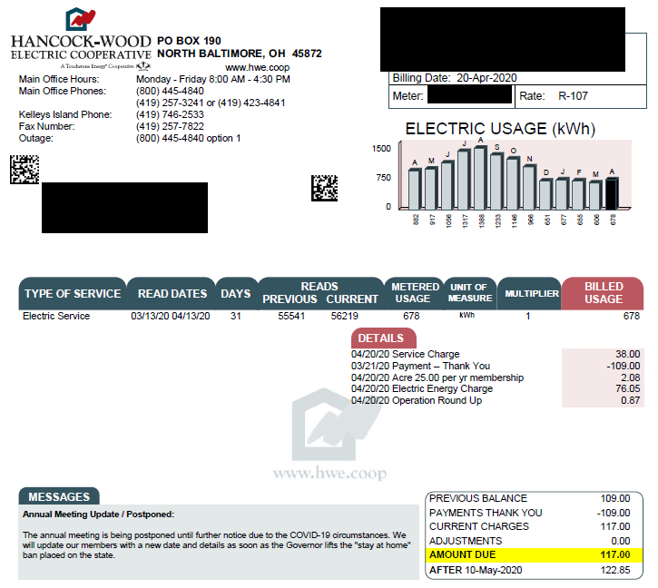
Requirement 9
To figure out how much your electricity bill will be, you must know how much your electric company charges per kilowatt-hour.
You can find this out by looking at your family’s electric bills.
If the bill does not show a price per kilowatt-hour, you can get a close estimate by dividing the amount of the bill by the kilowatt-hours used.

Slide 36
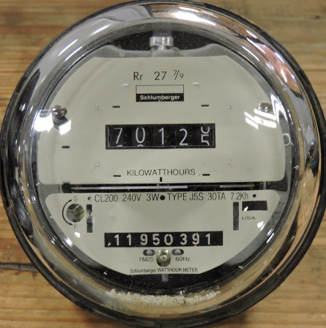
Requirement 9
To figure out your electric consumption during a month, simply subtract the reading taken from the electric meter at the beginning of the month from the reading taken at the end of the month.

Slide 37
Requirement 9
Do the following:
  Discuss with your counselor five ways in which your family can conserve energy.

Slide 38
Requirement 9
The five keys to good energy management are:
  Know your electric utility rates.
  Know how much energy you are using.
  Know where you are using the energy.
  Know when you are using the energy.
  Implement simple energy-management techniques.

Slide 39

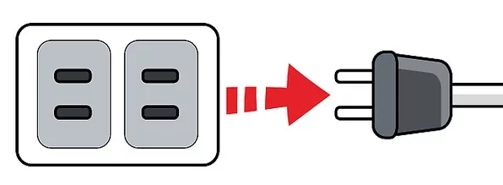
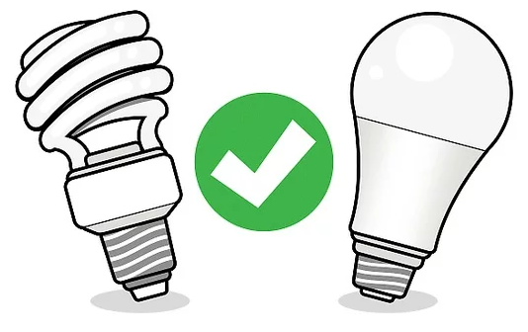
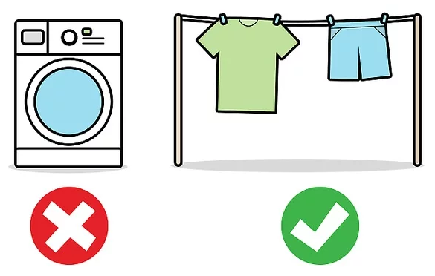
Requirement 9
Several ways to conserve energy:
  Unplug devices you’re not using.
  Turn off unnecessary lights.
  Replace your old light bulbs with energy-efficient LEDs.
  Only run full loads of laundry and dry clothes on a line.
  Take shorter showers.
  Not home? Turn off the air conditioner.
  Skip the heat-dry setting for the dishwasher.
  Thaw your frozen foods before you cook them.

Slide 40
Requirement 10
Explain the following electrical terms:
Volt | Ampere | Watt
Ohm | Resistance | Potential Difference
Rectifier | Rheostat | Conductor
Ground | Circuit | Short Circuit

Slide 41
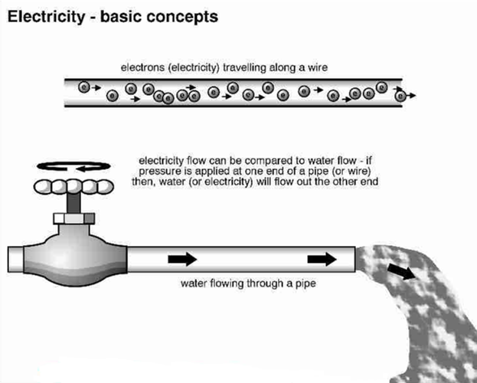
Requirement 10
Volt
A unit of potential difference, or a unit of measurement of electrical pressure or force, abbreviated V.
Voltage. Pressure at which a circuit operates, expressed in volts.
  Voltage is like the pressure in a water pipe.
  For example, 120 volts have twice the pushing force of 60 volts.
Voltmeter. An instrument for measuring the difference in electric potential (electrical pressure) between two points.

Slide 42
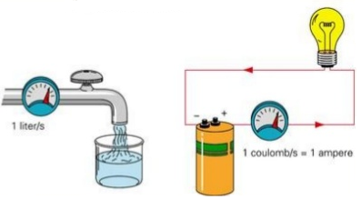
Requirement 10
Ampere
A unit measuring the strength of an electrical current, based on the number of electrons transferring past a given point per second.
Many elements of a wiring system are rated in amperes for the greatest amount of current they can safely carry.
The ampere, abbreviated amp, is named for French physicist Andre-Marie Ampere.
Ammeter. An instrument for measuring current in amperes.

Slide 43
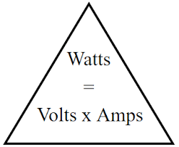
Requirement 10
Watt
Unit that measures electrical power at the point where it is used in a circuit.
One watt of power equals one volt of pressure times one ampere of current.
Many electrical devices are rated in watts according to the power they consume, abbreviated W.

Slide 44
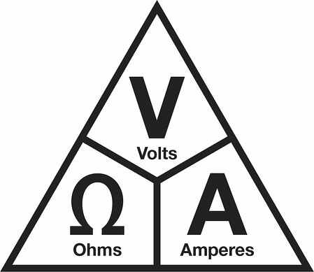
Requirement 10
Ohm
A unit of measurement for electrical resistance to a current.
It is named for German physicist Georg Simon Ohm (1787–1854).
Ohm’s law states that Voltage = Current X Resistance.
This simple formula shows the relationship between volts, amperes, and resistance in any electric circuit.

Slide 45
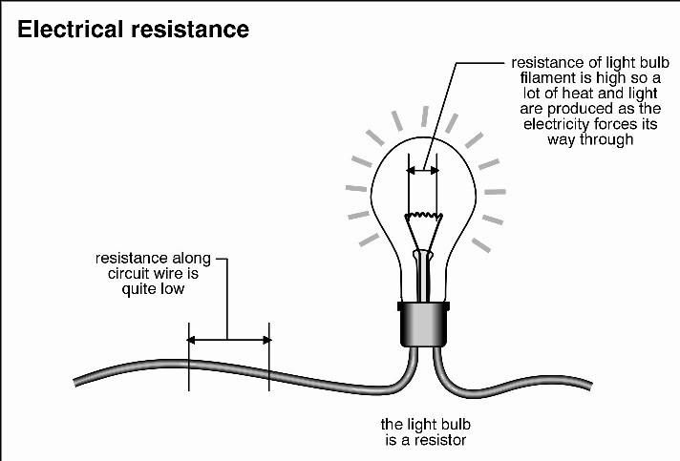
Requirement 10
Resistance
The opposition against the free transfer of electrons in a conductor. Measured in ohms.
Resistor. A device designed to restrict the transfer of current in (or introduce resistance into) an electric circuit.

Slide 46
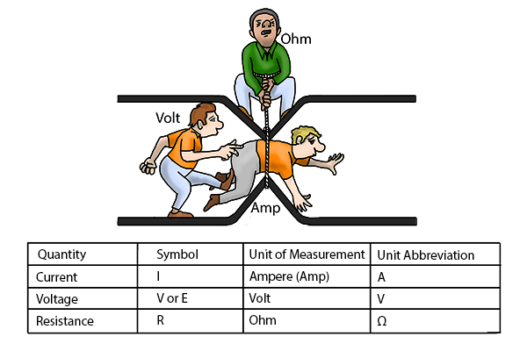
Requirement 10
Comparing Amperes, Voltage, and Ohms.

Slide 47
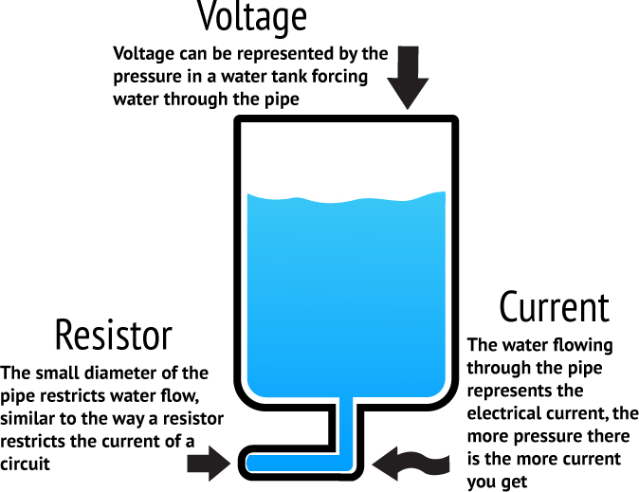
Requirement 10
Potential Difference
Every object charged with electricity has a certain potential or electromotive force.
When two objects with different potentials are connected with a wire, electrons move from where there are many to where there are few.
This is how the transfer of electrons takes place.
This potential difference between electromotive forces causes the electrons to travel along the wire attempting to equalize the two potentials until the circuit is opened.
Potential difference is measured in volts (V) and is also called voltage.

Slide 48
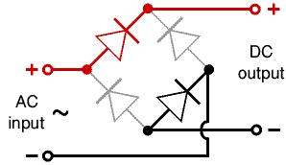
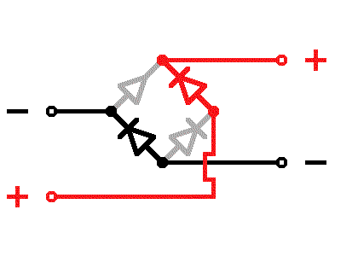
Requirement 10
Rectifier
An electrical device which converts an alternating current into a direct one by allowing a current to flow through it in one direction only.

Slide 49
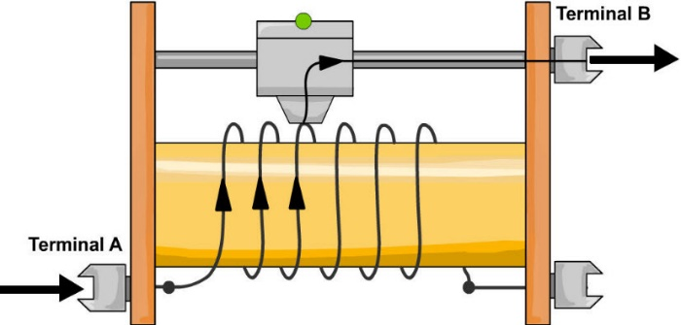
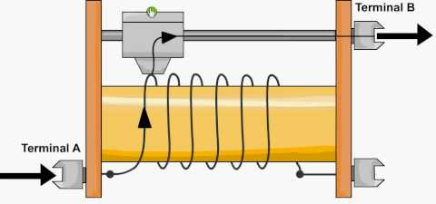
Requirement 10
Rheostat
A resistor built so that the current traveling through the circuit can be adjusted at will. Volume controls and dimmer switches are examples.
Dim Light
Bright Light

Slide 50
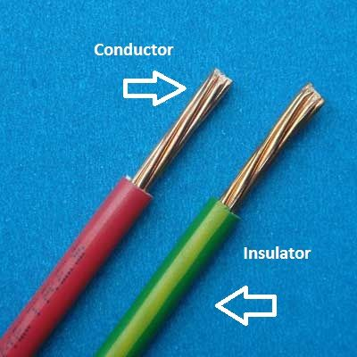
Requirement 10
Conductor
A substance or device through which electricity passes.
Most metals are good conductors of electricity—that is, they allow electricity to travel through them with little resistance.
Gold and silver are the best conductors of electricity but are too expensive for general use.
Copper, which is relatively cheap and plentiful, is used most often, especially in transmission lines that carry electricity from power plants to homes, schools, and businesses.
Aluminum is not as good a conductor as copper, but because it is cheaper and lighter, it is also frequently used.

Slide 51
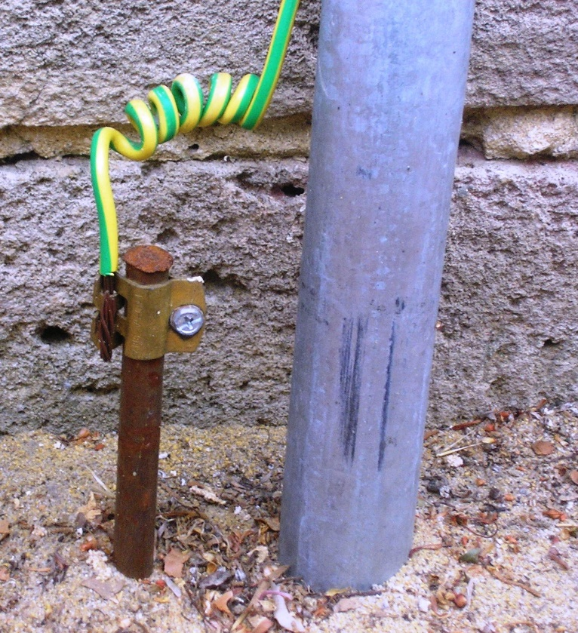
Requirement 10
Ground
To connect any part of an electrical wiring system to the ground or to another conducting body, such as a metal water pipe or a metal rod driven into the earth.
Grounding wire. Conductor that grounds a metal component but does not carry current during normal operation.

Slide 52
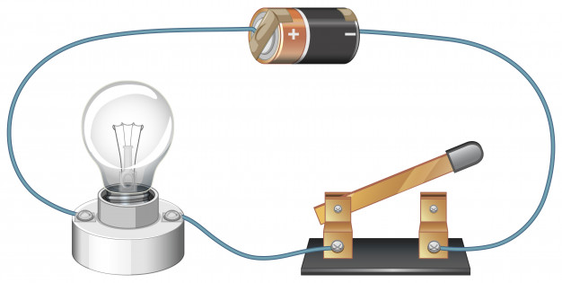
Requirement 10
Circuit
A loop-shaped path through which electric current travels from the source through some device using electricity, such as a lightbulb, and back to the source.

Slide 53
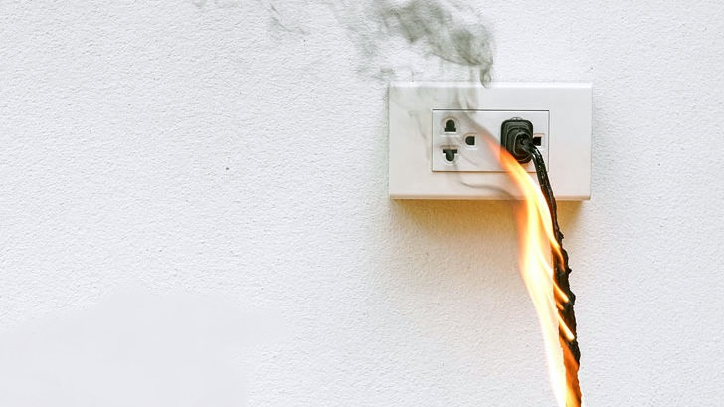
Requirement 10
Short Circuit
A completed, low-resistance circuit that allows electrons to follow a shorter, unintended path back to the power source rather than follow the longer path that goes through the load.
Occurs when bare wires touch each other that often results from worn insulation.
Creates fire hazards.

Slide 54
Requirement 11
Do any TWO of the following:
  Connect a buzzer, bell, or light with a battery. Have a key or switch in the line.

Slide 55
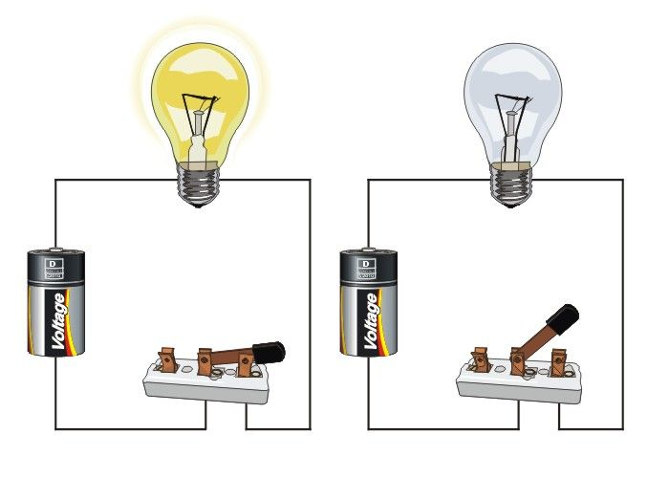
Requirement 11
Download the instructions titled “How to Make a Simple Circuit with a Switch” found with this presentation.

Slide 56
Requirement 11
Do any TWO of the following:
  Make and run a simple electric motor (not from a kit).

Slide 57
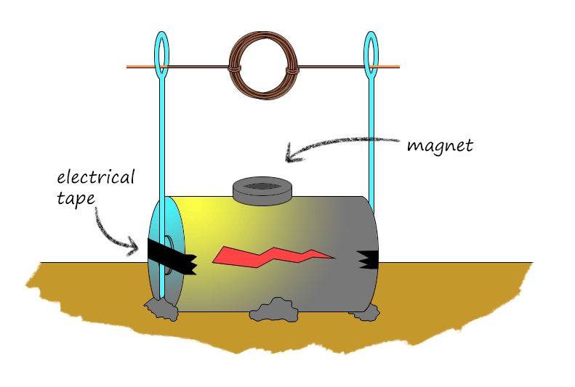
Requirement 11
A simple electric motor is little more than a spinning magnet.
Download the instructions titled “How to Make a Simple Electric Motor” found with this presentation.

Slide 58
Requirement 11
Do any TWO of the following:
  Build a simple rheostat. Show that it works.

Slide 59
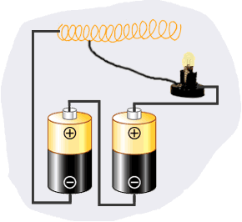
Requirement 11
Download the instructions titled “How to Make a Rheostat” found with this presentation.

Slide 60
Requirement 11
Do any TWO of the following:
  Build a single-pole, double-throw switch. Show that it works.

Slide 61
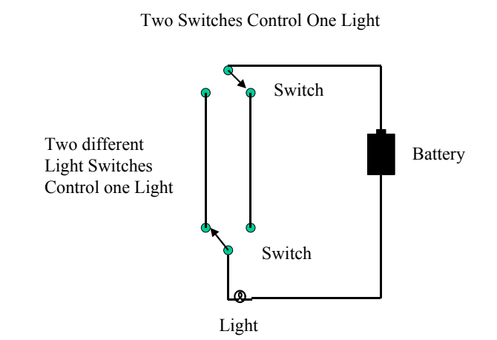
Requirement 11
Download the instructions titled “How to Build a Single Pole Double Pole Switch” found with this presentation.

Slide 62
Requirement 11
Do any TWO of the following:
  Hook a model electric train layout to a house circuit. Tell how it works.

Slide 63
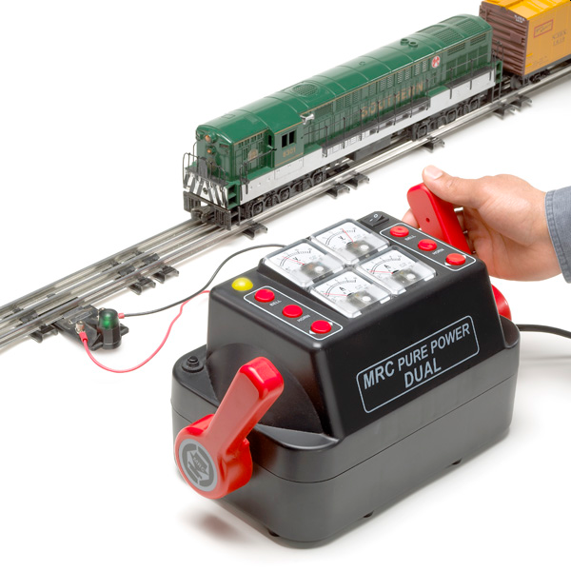
Requirement 11
Model Electric Train
Never connect your train directly to an electrical outlet.
Always use an electric train transformer, which changes the higher voltage electric power (usually 115 to 120 volts) found in your home to the low voltage required for operating toy trains (from 8 to 18 volts).
The transformer cord is plugged into any convenient wall outlet.
Low voltage is then obtained from the binding posts on top or in back of the transformer.

